Slide 1
Models in django
Django mastery course in Nepali

Slide 2


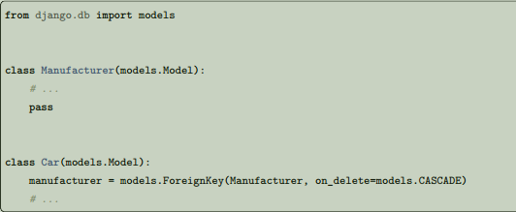
Relationships
Clearly, the power of relational databases lies in relating tables to each other. Django offers ways to define the three most common types of database relationships: many-to-one, many-to-many and one-to-one.
Many-to-one relationships
To define a many-to-one relationship, use django.db.models.ForeignKey. You use it just like any other
Field type: by including it as a class attribute of your model.
ForeignKey requires a positional argument: the class to which the model is related. For example, if a Car model has a Manufacturer – that is, a Manufacturer makes multiple cars but each Car only has one Manufacturer – use the following definitions:

Slide 3
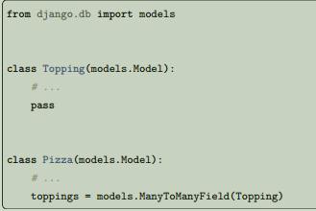
Many-to-many relationships
To define a many-to-many relationship, use ManyToManyField. You use it just like any other Field type: by including it as a class attribute of your model. ManyToManyField requires a positional argument: the class to which the model is related. For example, if a Pizza has multiple Topping objects – that is, a Topping can be on multiple pizzas and each
Pizza has multiple toppings – here’s how you’d represent that:
It doesn’t matter which model has the ManyToManyField, but you should only put it in one of the models – not both.
Generally, ManyToManyField instances should go in the object that’s going to be edited on a form. In the above example, toppings is in Pizza (rather than Topping having a pizzas ManyToManyField ) because it’s more natural to think about a pizza having toppings than a topping being on multiple pizzas. The way it’s set up above, the Pizza form would let users select the toppings.

Slide 4
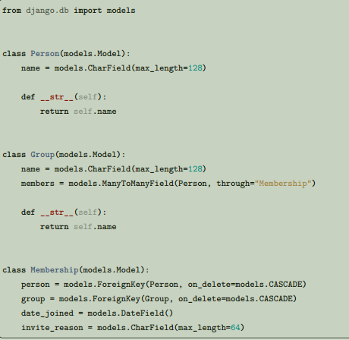
Extra fields on many-to-many relationships
When you’re only dealing with many-to-many relationships such as mixing and matching pizzas and toppings, a standard ManyToManyField is all you need. However, sometimes you may need to associate data with the relationship between two models. For example, consider the case of an application tracking the musical groups which musicians belong to . There is a many-to-many relationship between a person and the groups of which they are a member, so you could use a ManyToManyField to represent this relationship. However, there is a lot of detail about the membership that you might want to collect, such as the date at which the person joined the group. For these situations, Django allows you to specify the model that will be used to govern the many-to-many relationship. You can then put extra fields on the intermediate model. The intermediate model is associated with the ManyToManyField using the through argument to point to the model that will act as an intermediary. For our musician example, the code would look something like this:
When you set up the intermediary model, you explicitly specify foreign keys to the models that are involved in the many-to-many relationship. This explicit declaration defines how the two models are related.
There are a few restrictions on the intermediate model:
• Your intermediate model must contain one - and only one - foreign key to the source model (this would be Group in our example), or you must explicitly specify the foreign keys Django should use for the relationship using ManyToManyField.through_fields. If you have more than one foreign key and through_fields is not specified, a validation error will be raised. A similar restriction applies to the foreign key to the target model (this would be Person in our example).
• For a model which has a many-to-many relationship to itself through an intermediary model, two foreign keys to the same model are permitted, but they will be treated as the two (different) sides of the many-to-many relationship. If there are more than two foreign keys though, you must also specify through_fields as above, or a validation error will be raised.
Now that you have set up your ManyToManyField to use your intermediary model (Membership, in this case), you’re ready to start creating some many-to-many relationships. You do this by creating instances of the intermediate model:

Slide 5
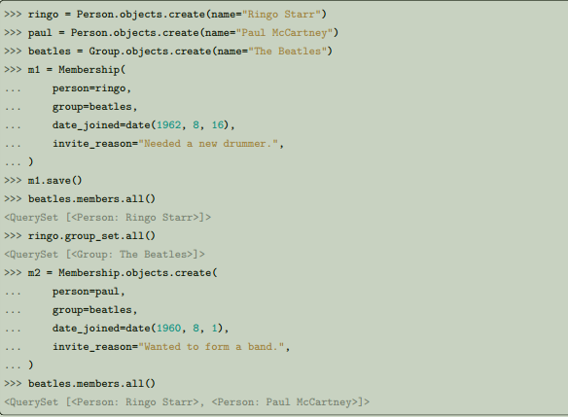
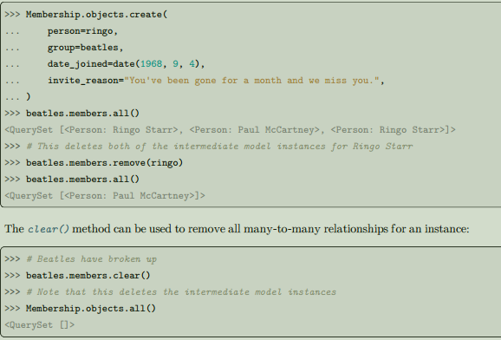
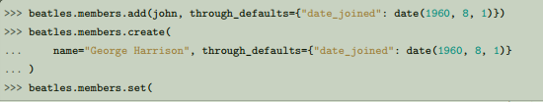

You may prefer to create instances of the intermediate model directly. If the custom through table defined by the intermediate model does not enforce uniqueness on the (model1,
model2) pair, allowing multiple values, the remove() call will remove all intermediate model instances:
You can also use add(), create(), or set() to create relationships, as long as you specify through_defaults for any required fields:
Once you have established the many-to-many relationships, you can issue queries. Just as with normal many to-many relationships, you can query using the attributes of the many-to-many-related model:

Slide 6
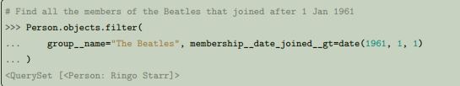
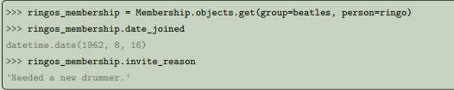
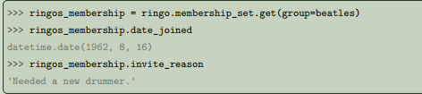
One-to-one relationships
To define a one-to-one relationship, use OneToOneField. You use it just like any other Field type: by including it as a class attribute of your model. This is most useful on the primary key of an object when that object “extends” another object in some way. OneToOneField requires a positional argument: the class to which the model is related. For example, if you were building a database of “places”, you would build pretty standard stuff such as address, phone number, etc. in the database. Then, if you wanted to build a database of restaurants on top of the places, instead of repeating yourself and replicating those fields in the Restaurant model, you could make Restaurant have a OneToOneField to Place (because a restaurant “is a” place; in fact, to handle this you’d typically use inheritance, which involves an implicit one-to-one relation).

Slide 7
Models across files
It’s perfectly OK to relate a model to one from another app. To do this, import the related model at the top of the file where your model is defined. Then, refer to the other model class wherever needed.
Custom field types
If one of the existing model fields cannot be used to fit your purposes, or if you wish to take advantage of some less common database column types, you can create your own field class.
Meta options
Give your model metadata by using an inner class Meta, Model metadata is “anything that’s not a field”, such as ordering options (ordering), database table name (db_table), or human-readable singular and plural names (verbose_name and verbose_name_plural). None are required, and adding class Meta to a model is completely optional.
Model attributes
objects
The most important attribute of a model is the Manager. It’s the interface through which database query operations are provided to Django models and is used to retrieve the instances from the database. If no custom Manager is defined, the default name is objects. Managers are only accessible via model classes, not the model instances.
Model methods
Define custom methods on a model to add custom “row-level” functionality to your objects. Whereas Manager methods are intended to do “table-wide” things, model methods should act on a particular model instance. This is a valuable technique for keeping business logic in one place – the model.
__str__()
A Python “magic method” that returns a string representation of any object. This is what Python and Django will use whenever a model instance needs to be coerced and displayed as a plain string. Most notably, this happens when you display an object in an interactive console or in the admin. You’ll always want to define this method; the default isn’t very helpful at all.
get_absolute_url()
This tells Django how to calculate the URL for an object. Django uses this in its admin interface, andany time it needs to figure out a URL for an object. Any object that has a URL that uniquely identifies it should define this method.

Slide 8
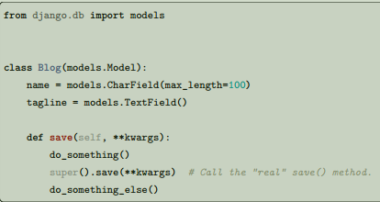
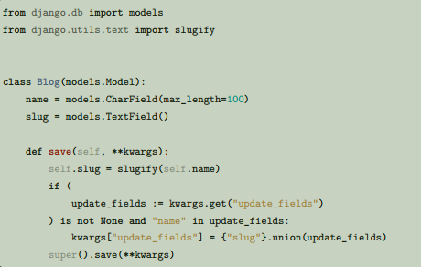
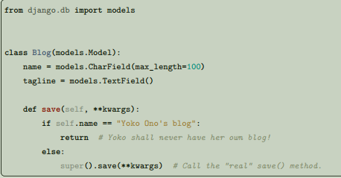
Overriding predefined model methods
There’s another set of model methods that encapsulate a bunch of database behavior that you’ll want to customize. In particular you’ll often want to change the way save() and delete() work. You’re free to override these methods (and any other model method) to alter behavior. A classic use-case for overriding the built-in methods is if you want something to happen whenever you save an object.
If you wish to update a field value in the save() method, you may also want to have this field added to the
Note that the delete() method for an object is not necessarily called when deleting objects in bulk using a QuerySet or as a result of a cascading delete. To ensure customized delete logic gets executed, you can use pre_delete and/or post_delete signals. Unfortunately, there isn’t a workaround when creating or updating objects in bulk, since none of save(), pre_save, and post_save are called.

Slide 9
Break………… Done

